Slide 1




LASER INTRUSION
SYSTEM

Slide 2


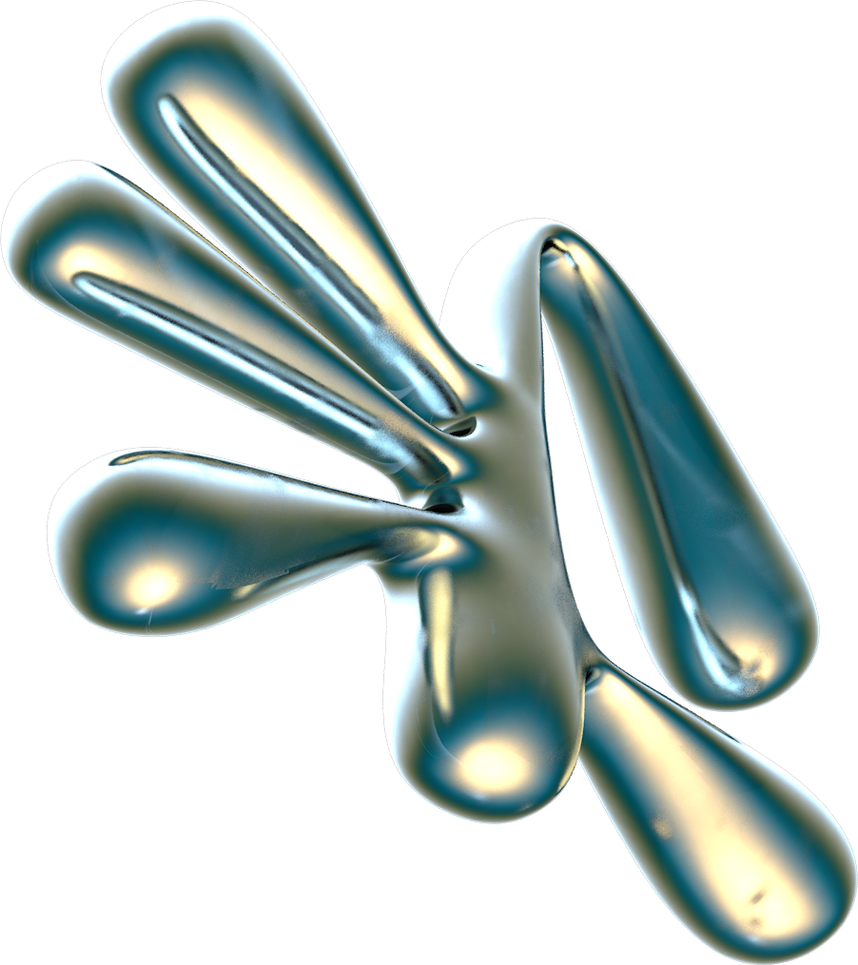
TABLE OF CONTENTS
01.
02.
Abstract And Objective
Hardware And Software Logic
03.
04.
Applications And Limitations
Future Scope And Conclusion

Slide 3


This project presents the design and development of a Laser Intrusion Detection System, a compact, low-cost, and efficient security setup used to detect unauthorized entry by breaking a laser beam. The system is implemented as a museum protection model, where a priceless artifact is safeguarded using multiple laser beams and light sensors. When an intruder crosses the laser grid, the Arduino Nano detects the interruption through LDR and infrared sensors and triggers an alarm. The project integrates both hardware and software automation, demonstrating real-world applications in museums, banks, and jewellery stores.

Slide 4

WHAT ARE THE
OBJECTIVES?
1.
2.
3.
4.
To design a laser-based intrusion detection system using sensors and microcontrollers
To create a museum-style sun board model demonstrating real-world security usage.
To implement a multi-zone laser grid with redundant detection for reliability.
To develop an alert system triggered by laser and infrared interruption.

Slide 5
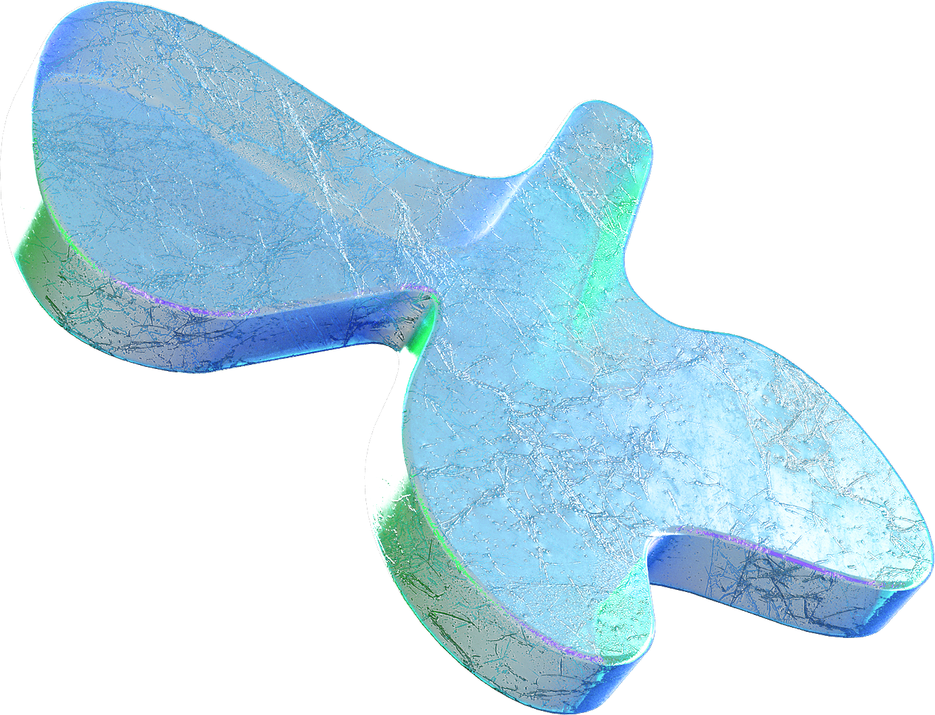

Micro
Controllers
Sensors & Modules
Power &
Driver Circuit
Arduino Nano – sensor control, alarm logic
LDRs
Infrared Sensor
Laser Diodes
OLED Display and Buzzer
Red and Blue LED
Lithium Polymer Battery giving 12v supply with 5200 Mah Power • 5V DC-DC Step down converter • NPN transistors
KEY COMPONENTS

Slide 6
HARDWARE LOGIC
a) Each laser shines directly onto its corresponding LDR. • Normal: Laser falls on LDR → low resistance → safe • Intrusion: Laser blocked → LDR resistance rises → Arduino triggers buzzer + alarm LEDs This creates a 2-point perimeter protection around the artifact.
b) IR Sensor Artifact Removal Detection An IR reflective sensor is placed under the artifact. When the artifact is present, IR reflection is strong. If someone lifts the artifact: • IR reflection drops • Arduino detects the removal • Immediately triggers 12V buzzer and red LEDs This provides direct object theft detection.
c) OLED Display Shows live system status: SYSTEM ARMED LASER1: OK LASER2: OK ARTIFACT: SAFE On intrusion: *** ALERT *** LASER BREACH! On artifact removal: !!! ARTIFACT TAKEN!!!
d) Alarm System • 12V buzzer is driven using a transistor or MOSFET • Red LEDs flash during alert • Blue LEDs stay ON as museum lighting (optional)

Slide 7
SOFTWARE LOGIC
The system protects a museum artifact using two optical beams and an under-pedestal proximity sensor. Each laser projects a beam onto an LDR positioned opposite it. A separate IR reflectance sensor beneath the artifact detects removal. The Arduino Nano continuously monitors sensor readings; when any laser beam is interrupted or the IR sensor indicates the artifact has been lifted, the controller triggers the alarm chain (12V buzzer + red LEDs) and updates the OLED display.
Normal Condition
Laser directly shines on LDR → o LDR1 gives a high analog reading (v1 > th1) o LDR2 gives a low analog reading (v2 < th2) • Arduino marks both beams as stable.
Intrusion Condition
When an object or hand crosses the beam: • LDR1: its value drops below threshold th1 • LDR2: its value rises above threshold th2 The code reads: if (v1 < th1) → Beam 1 triggered if (v2 > th2) → Beam 2 triggered Once detected: • The system immediately runs triggerAlarm() • Red LEDs flash • Blue LEDs turn OFF • Buzzer outputs siren pattern • OLED displays the specific breached beam (“Beam 1 Active” or “Beam 2 Break”) This forms the PRIMARY INTRUSION DETECTION.

Slide 8
SOFTWARE LOGIC
Artifact Removal Detection (IR Sensor) An IR sensor is mounted underneath the artifact platform. Working Logic • When the artifact is present → the IR sensor receives reflected IR light → its digital output remains LOW. • When the artifact is lifted → reflection disappears → sensor output becomes HIGH. The code checks this condition: if (irState == HIGH) triggerAlarm("Artifact Taken"); This is a direct theft detection independent of laser beams. EVEN IF SOMEONE BYPASSES THE LASERS, LIFTING THE ARTIFACT WILL TRIGGER THE ALARM.
Alarm Activation Mechanism
Whenever any one of the three triggers occurs:
1. Beam 1 interrupted
2. Beam 2 interrupted
3. Artifact removed
The system immediately executes: triggerAlarm(msg); This function: • Clears OLED and prints “ALARM!” • Shows the cause (Beam 1, Beam 2, or Artifact) • Turns OFF both blue LEDs • Activates alarmSiren(),
which: Pulses buzzer ON/OFF o Flashes both red LEDs in sync o Repeats this for 6 cycles A cooldown period prevents rapid reactivation: if (millis() - lastAlarmTime < alarmCooldown) return: This ensures the alarm plays fully once before it can trigger again.

Slide 9
SOFTWARE LOGIC
Status LEDs:
Blue (Ambient): Always ON during monitoring; turns OFF during alarms.
Red (Warning): Flashes rapidly when an alarm is triggered.
Beam Status: Illuminates to identify specifically which beam has failed (diagnostic aid).
OLED Display:
Normal Mode: Displays "SYSTEM ARMED" with live beam values.
Alarm Mode: Shows specific triggers (e.g., "Artifact Taken", "Beam Break") and resets after cooldown.
Boot Sequence (hackerBoot()):
Runs a custom startup animation with simulated system checks, progress bars, and sound effects to signal readiness.
Power Distribution:
5V Rail: A buck converter steps down 12V to power the Arduino, OLED, LDRs, and LEDs.
12V Rail: Powers the high-volume buzzer directly.

Slide 10
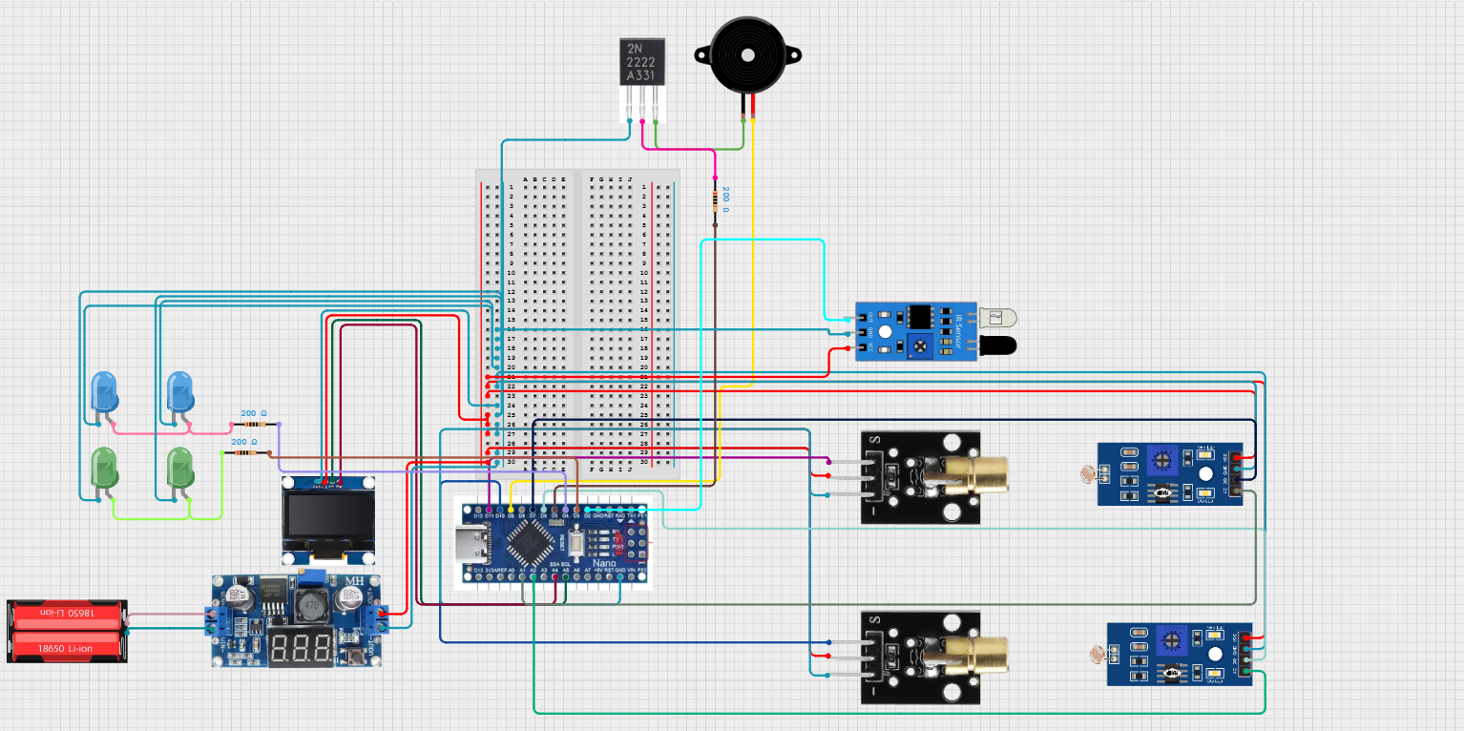
CIRCUIT DIAGRAM

Slide 11

Museum Artifact Protection
Jewellery Store Display Security
he system is designed specifically to protect valuable artifacts by detecting:
Removal of the object itself Hand movement or intrusion into the display area
This makes it ideal for exhibitions and museum showcases.
Jewellery shops often use glass cases with valuables placed inside.
Dual laser beams and an IR removal sensor can immediately detect: Theft attempts Opening of the glass case • Removal of jewellery from its stand
APPLICATIONS
Trophy and Award Showcases
Sensitive Equipment & Research Labs
Schools, universities, and institutions can use the system to protect trophies and awards displayed in open cabinets.
Laboratories can install such detectors around: Instruments
Samples
Tools or equipment that must not be touched

Slide 12

Dual-Level Protection
Fast and Accurate Response
The combination of: Laser interruption detection, and IR artifact removal detection makes the system highly reliable. Even if one method is bypassed, the other triggers the alarm.
Both LDR and IR sensors provide immediate feedback to the Arduino, enabling:
Quick detection
Fast buzzer activation Accurate OLED alerts
ADVANTAGES
Low Cost and Easy to Build
Modular and Expandable
More beams, IR sensors, or wireless modules (ESP32, GSM, RF) can be added easily
The hardware consists of affordable components

Slide 13
LIMITATIONS
Laser Alignment Sensitivity The system relies on accurate laser-to-LDR alignment. Slight vibrations, physical movement, or misalignment over time can cause false alarms or reduced detection accuracy.
2. Ambient Light Interference Strong sunlight, reflections, or room lighting can affect LDR readings. Although thresholds minimize this issue, LDRs are inherently sensitive to ambient conditions.
3. IR Sensor Reflectivity Dependence The IR sensor depends on the material and colour of the artifact. Very dark, matte, or IR-absorbing materials may reduce reflectivity, requiring recalibration.
4. Limited Coverage Area The current model uses only two laser beams. An intruder could technically reach the object through an uncovered angle unless the physical layout is perfect.
5. Requires Manual Reset After Alarm The system uses cooldown-based alarm locking. It does not automatically reset or re-arm unless coded to do so, which limits convenience in real installations.
6. No Wireless Communication by Default The current system does not send SMS, app notifications, or Wi-Fi alerts. Detection is limited to local buzzer + LEDs + OLED.

Slide 14

FUTURE SCOPE
1. Add WiFi / GSM Alerts Integrating ESP32, SIM800L, or IoT platforms can enable: • SMS alerts • Mobile app notifications Email alarms Cloud dashboard logging This makes the system deployable.
2. Add More Laser Zones Implementing 4–6 beams from multiple directions will provide: Full 360° coverage Zero blind spots A real “laser grid” experience Mirrors or IR beams can also be added.
3. Add a Camera Module Automatically capture images or short videos during intrusion: • Identify intruder Provide evidence • Real-time monitoring
4. Auto-Recalibration of Thresholds
5. Implement Password-Based Arming / Disarming Add a keypad or RFID module: • Prevent false alarms • Only authorized users can disable system

Slide 15

CONCLUSION
The developed Laser and IR-Based Artifact Security System successfully demonstrate a reliable and efficient method for protecting valuable objects using low-cost electronic components. By integrating two laser–LDR intrusion channels along with a dedicated IR removal sensor, the system ensures dual-layer protection, making it highly responsive to both beam interruption and direct object theft.
The Arduino Nano effectively handles real-time sensor monitoring, threshold evaluation, and alarm activation, while the OLED display provides live feedback and system status information. The 12V high-power buzzer and flashing red LEDs deliver immediate audible and visual alerts during intrusion conditions. The system’s power is regulated through a buck converter and custom 5V PCB rail, ensuring stable and noise-free operation even when the alarm is active.
The physical sun board model replicates a miniature museum environment, showcasing how real-world security systems protect artifacts in exhibitions, jewellery stores, and display cases. Overall, the project combines practicality, creativity, and engineering principles to create a compact and effective security prototype. It demonstrates strong understanding of sensors, embedded systems, and model integration, making it a valuable and successful engineering project.

Slide 16
THANK YOU

